Slide 1

Smart To-Do List Manager with Reminders and Email Alerts
CREATED BY JATIN KUMAR

Slide 2
Introduction:
In today’s fast-paced world, staying organized and managing time effectively is a common challenge faced by students, professionals, and individuals alike. This project introduces a Smart To-Do List Manager—a Python-based desktop application developed using Tkinter GUI, aimed at improving personal productivity.
The system allows users to create, organize, and manage tasks with added features like priority levels, due dates, search and sort options, and theme customization. What makes this project stand out is its automatic reminders via system notifications and email alerts when a task is approaching its deadline.
The app supports multi-user login, tracks tasks individually, and stores data securely in JSON format. It also offers Excel export functionality for backup and reporting purposes.

Slide 3
Technology Used:
Technology | Purpose
Python | Core programming language used to build the application
Tkinter | GUI library for building the desktop interface
JSON | For storing user tasks and credentials persistently
Plyer | To send system notifications/reminders
tkcalendar | For selecting due dates using a date picker widget
pandas | To export tasks into Excel format for reporting
smtplib & email | To send email alerts to users when tasks are near due
openpyxl | Backend library used by pandas for Excel operations

Slide 4
🚀 Project Approach:
Step | Activity | Description
1️⃣ | Requirement Analysis | Identified the need for organized task management with reminders.
2️⃣ | GUI Design (Tkinter) | Designed user interface with input fields, listbox, and functional buttons.
3️⃣ | Core Feature Development | Implemented Add, Edit, Delete, Mark as Done functionalities (CRUD).
4️⃣ | Data Persistence (JSON) | Stored tasks, user info, and settings per user in JSON format.
5️⃣ | Feature Enhancements | Added priority, due date, category, search, sort, and theme toggle options.
6️⃣ | Notification System | Used Plyer for system reminders on due date and SMTP for email alerts.
7️⃣ | Excel Export | Enabled data export using Pandas and OpenPyXL for backup/reporting.
8️⃣ | Testing & Validation | Tested with various users and task types to ensure robustness and correctness.

Slide 5
Challenges Faced:
Challenge | Description
User Data Structuring | Managing multi-user data (username + email + tasks) efficiently in JSON format.
Email Alert Integration | Setting up secure email alerts using SMTP with Gmail App Passwords.
Due Date Logic | Calculating 1-day-before conditions accurately using datetime and timedelta.
Tkinter UI Consistency | Maintaining layout consistency while adding multiple widgets dynamically.
Real-Time Reminder Notification | Ensuring reminders trigger only for due-today tasks without repeating.
Theme Toggle Compatibility | Adapting all widgets to support both light and dark themes dynamically.
Handling Edge Cases | Dealing with empty inputs, duplicate tasks, and unexpected user behavior.
JSON Corruption Prevention | Preventing crashes when users.json gets malformed or reset accidentally.

Slide 6
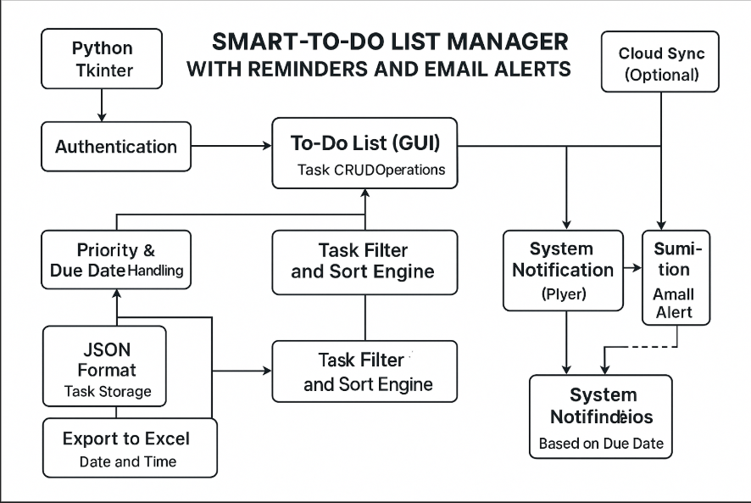
FLOWCHART

Slide 7
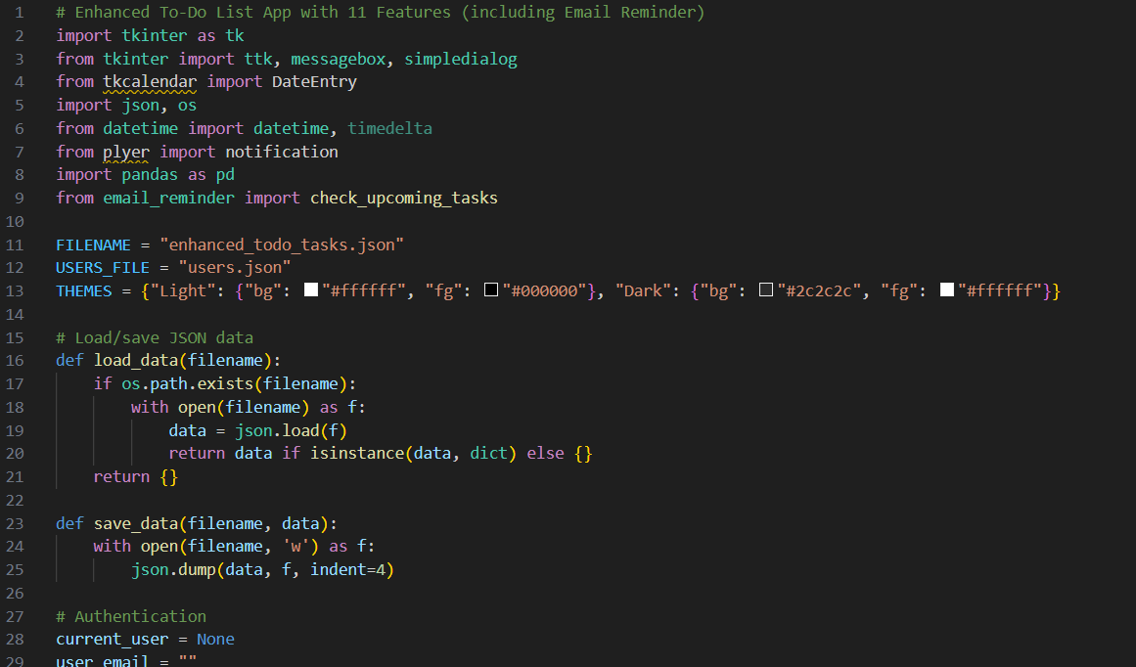

Slide 8
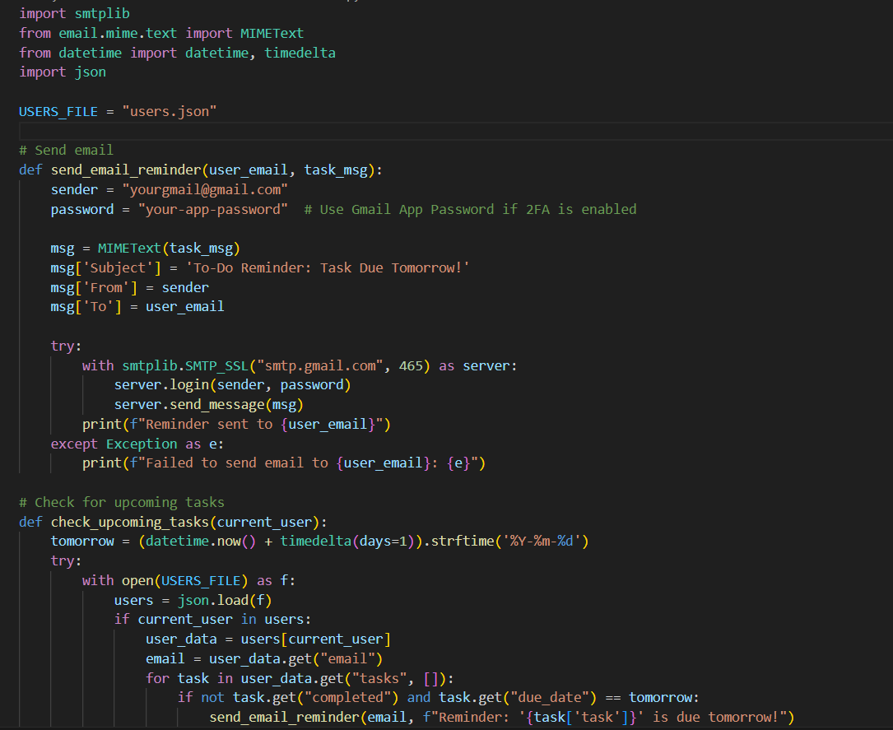

Slide 9
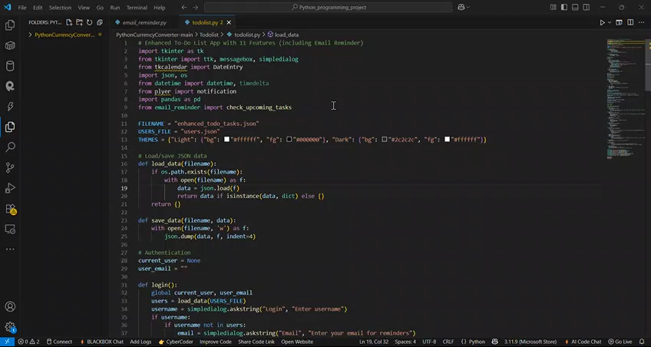

Slide 10
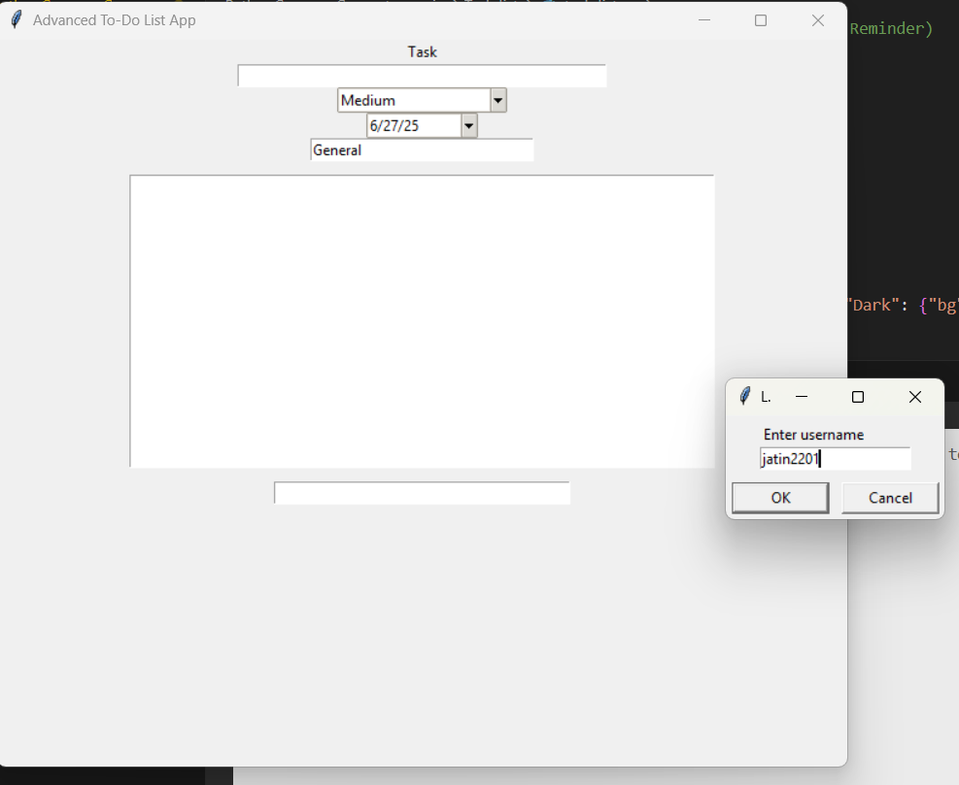
OUTPUT

Slide 11
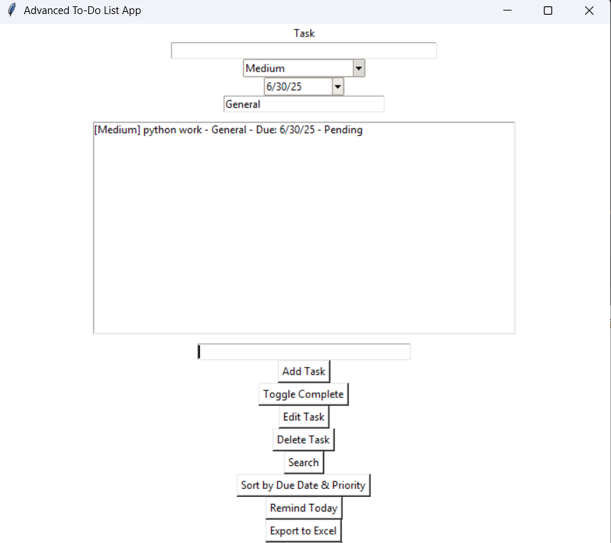
OUTPUT

Slide 12
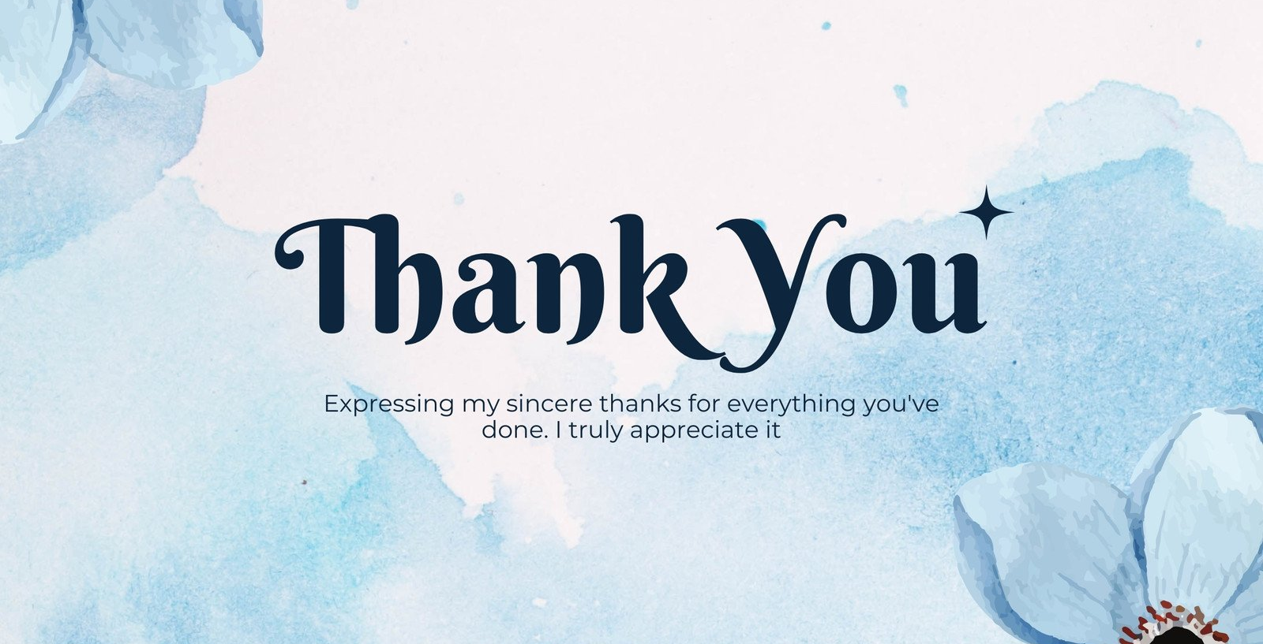
Project Title : Smart To-Do List Manager with Reminders and Email Alerts
SUBMITTED BY: JATIN KUMAR
SUBMITTED TO TAMIZHAN SKILLS

